Slide 1

Welcome To Ram Technologies Bangalore
Empowering the Next Generation of DevOps Engineers

Slide 2
Myself:
Name: Ram
Role: DevOps Architect
Experience: 13+ Years in IT, with 8+ years in DevOps
Passionate about automation, scalability, and cloud-native technologies
Committed to mentoring and upskilling future DevOps professionals

Slide 3

Professional Journey:
Started career as a Developer
Transitioned into DevOps as the industry shifted towards automation & CI/CD
Progressed through roles:
  Developer→DevOps Engineer → Senior DevOps Engineer → DevOps Lead → DevOps Architect
Experience working with startups, enterprises, and mission-critical environments

Slide 4
Technical Expertise:
Cloud Platforms: AWS, Azure, GCP
CI/CD: Jenkins, GitLab CI, Azure DevOps
Containers & Orchestration: Docker, Kubernetes, Helm
IaC Tools: Terraform, Ansible, CloudFormation
Monitoring & Logging: Prometheus, Grafana, ELK, Loki
Security: Vault, IAM, DevSecOps practices
Scripting: Bash, Python, YAML

Slide 5
My Roles and Responsibilities:
Design and implement end-to-end DevOps solutions
Build scalable CI/CD pipelines
Enable cloud infrastructure automation
Ensure security and compliance in DevOps pipelines
Promote DevOps culture across development & operations teams

Slide 6
Why I Teach?
Passionate about knowledge sharing
Realized the gap between theoretical and practical DevOps
Aim to provide industry-relevant, hands-on training
Want to mentor the next generation of DevOps professionals

Slide 7
What You Can Expect?
Hands-on labs and real-world project scenarios
Focus on core DevOps concepts + cloud-native tools
Tips for certifications, interviews, and career growth
Ongoing support, feedback, and mentorship

Slide 8
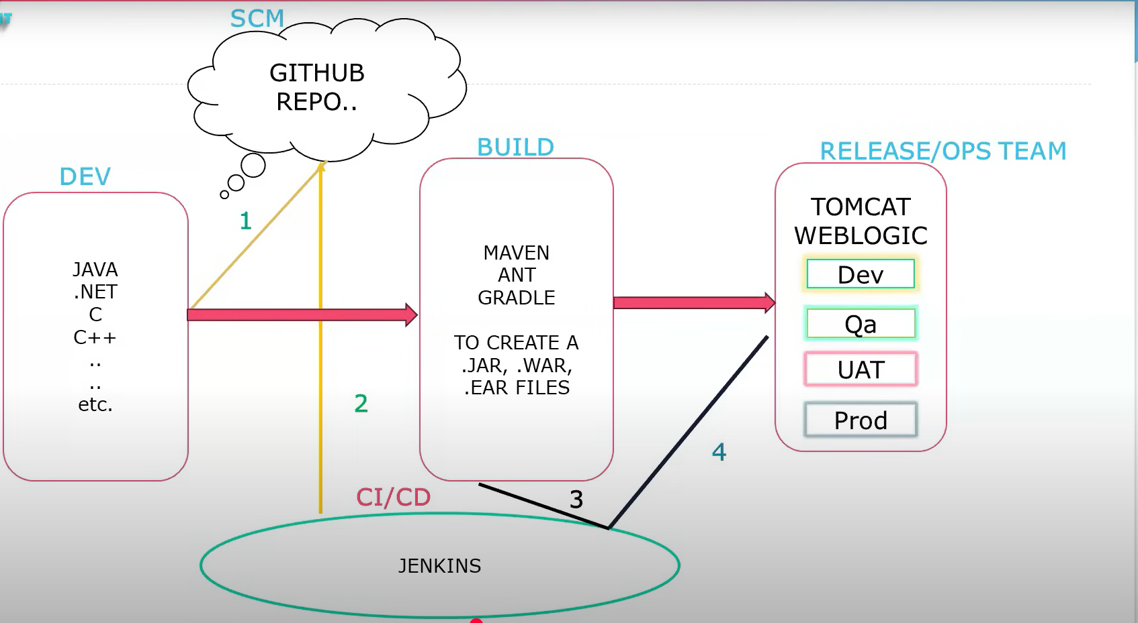

Slide 9
Software Development Life Cycle (SDLC)
The Software Development Life Cycle (SDLC) is a structured process that defines the stages involved in the development of software.
SDLC Models:
1.Waterfall Model
2.Agile
3.DevOps

Slide 10
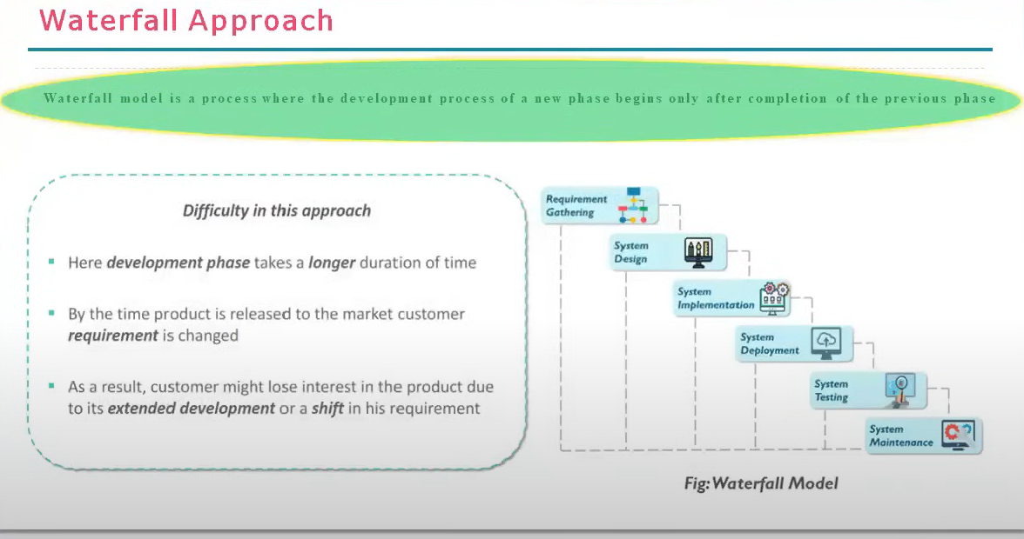

Slide 11
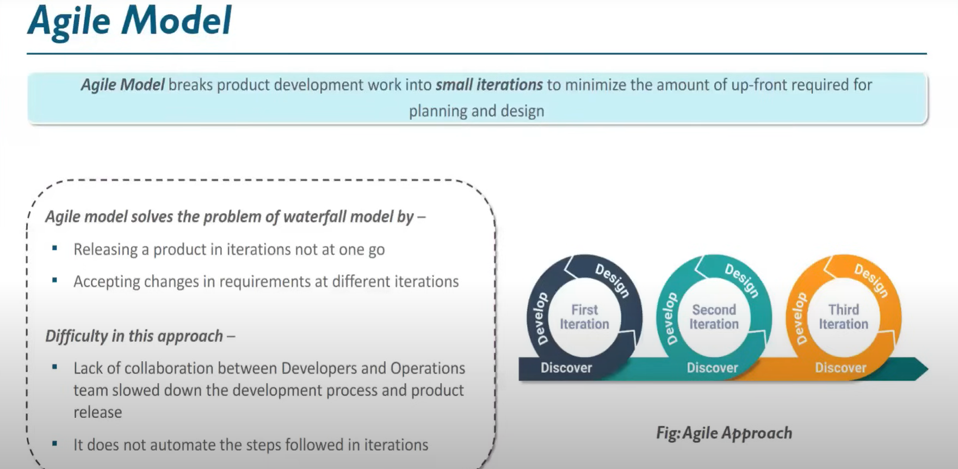

Slide 12
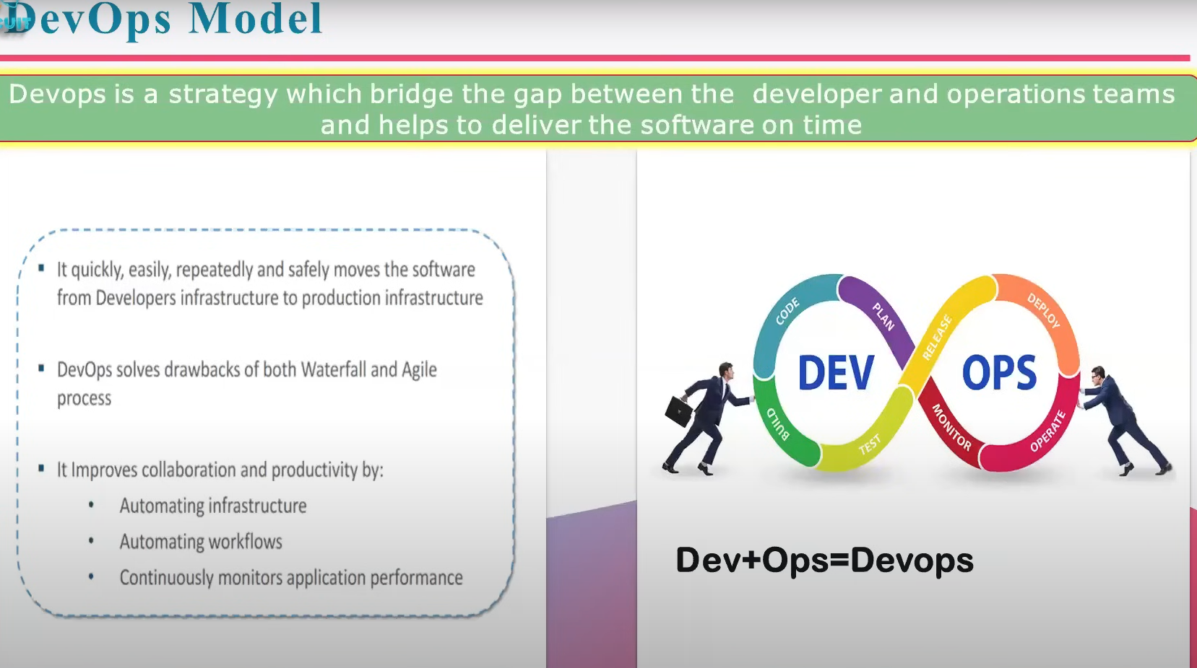

Slide 13
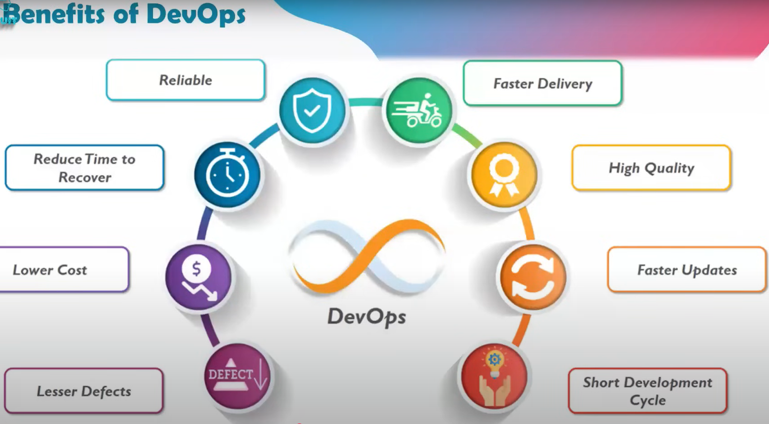
What is DevOps?
DevOps is a culture and set of practices that bring together software development (Dev) and IT operations (Ops) teams to collaborate throughout the software development lifecycle. The goal is to shorten development cycles, increase deployment frequency, and improve software quality.
Example: In DevOps, developers and operations teams work together on the same goals, using automation to streamline repetitive tasks like code deployment, configuration management, and testing.

Slide 14
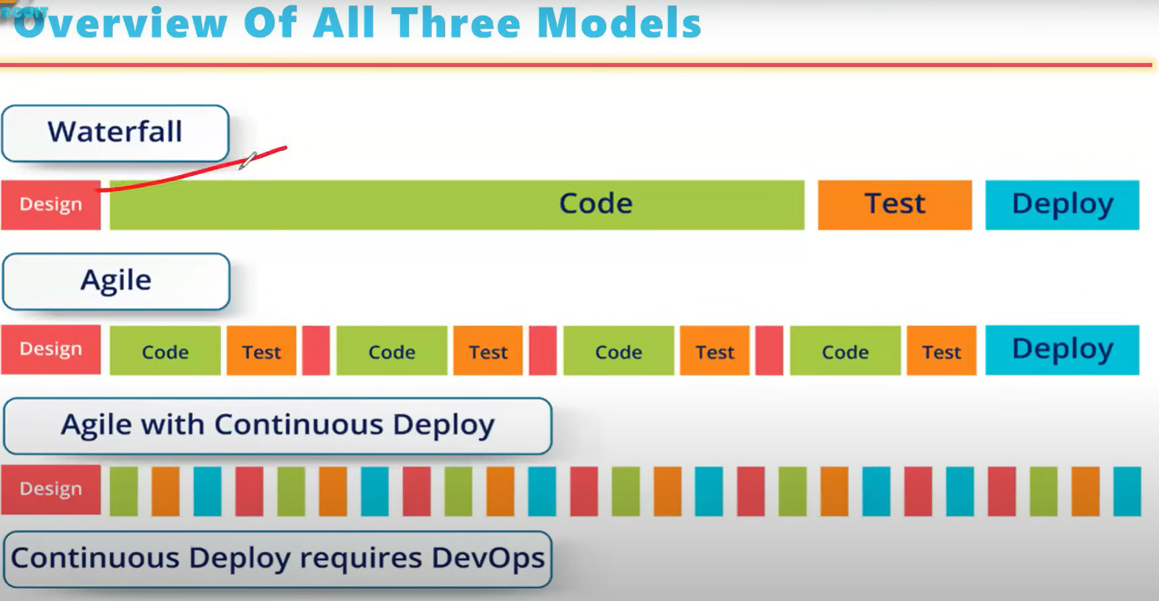

Slide 15
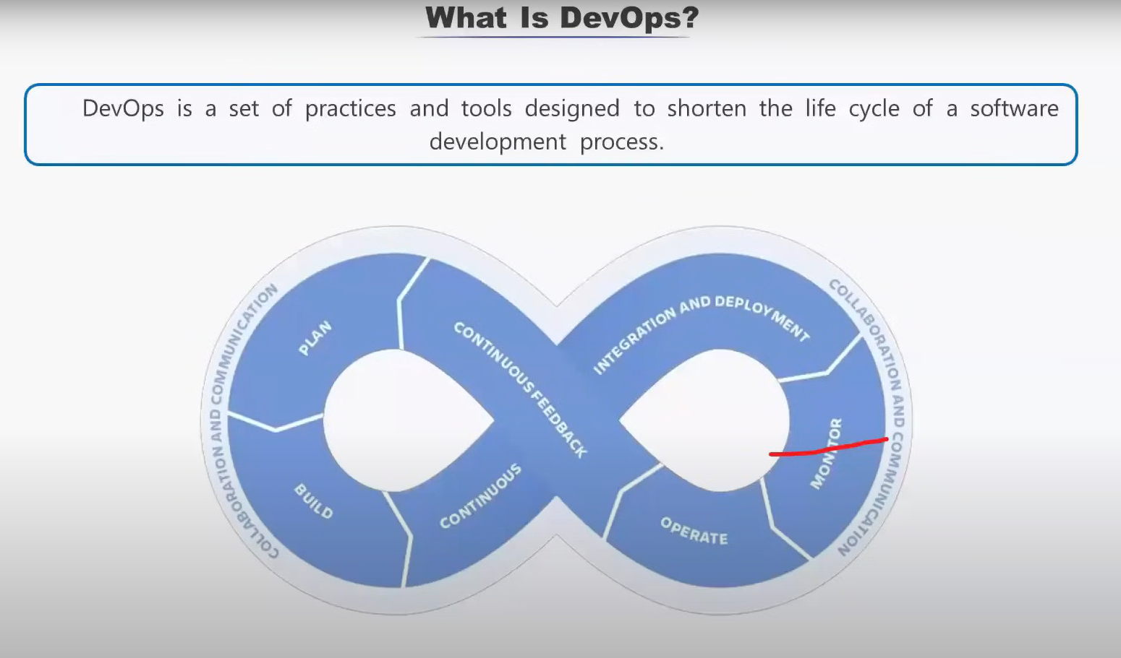

Slide 16
DevOps Model & Life Cycle
The DevOps lifecycle involves continuous development, integration, testing, deployment, and monitoring. It’s an iterative process aimed at ensuring fast, reliable, and efficient software delivery.
Continuous Development: Plan and write the code.
Continuous Integration (CI): Merge code into a shared repository regularly.
Continuous Testing: Automate testing to ensure that code works as expected.
Continuous Deployment (CD): Automatically deploy the application after successful testing.
Continuous Monitoring: Monitor the application and infrastructure for performance issues.

Slide 17
DevOps Tools Overview
DevOps tools are designed to automate and support various aspects of the DevOps lifecycle. Some popular tools include:
Jenkins – for Continuous Integration/Continuous Deployment.
Docker – for containerization.
Kubernetes – for container orchestration.
Terraform – for Infrastructure as Code.
Ansible/Chef/Puppet – for configuration management.
Nagios/Prometheus – for monitoring.

Slide 18
Market Trends & Career Scope
DevOps is rapidly growing, with more companies adopting DevOps practices to accelerate software delivery. The demand for skilled DevOps engineers is high, and many companies are looking for professionals with expertise in tools like Docker, Kubernetes, Jenkins, and Terraform.
Trends:
  Increased use of Cloud Services (AWS, Azure, GCP).
  Rise of Infrastructure as Code (IaC) tools like Terraform and Ansible.
  Growing focus on Security (DevSecOps), integrating security practices into the CI/CD pipeline.
  Expansion of Automation to improve efficiency.

Slide 19
Career Scope:
  DevOps Engineer
  Site Reliability Engineer (SRE)
  Cloud Engineer
  Automation Engineer
  Release Manager

Slide 20
Course Duration:2months
ClassTime: 7AM – 8:15AM
Days: Monday to Friday
Softcopy Material
Interview Questions and Answers
Resume Preparation
Interview Support
Job Support etc..

Slide 21
Thankyou!!

